Slide 1
Simple Network Management Protocol (SNMP)

Slide 2
What is Simple Network Management Protocol (SNMP)?
Simple Network Management Protocol (SNMP) is a widely used protocol for network management that provides a standardized framework for monitoring and managing network devices such as routers, switches, servers, and printers. It operates within the application layer of the Internet protocol suite and allows network administrators to manage network performance, find and solve network problems, and plan for network growth.
Simple Network Management Protocol (SNMP) is an Internet Standard protocol used for managing and monitoring network-connected devices in IP networks. SNMP is an application layer protocol that uses UDP port number 161/162.SNMP is used to monitor the network, detect network faults, and sometimes even to configure remote devices.

Slide 3
SNMP Architecture
The Simple Network Management Protocol (SNMP) architecture includes four layers.
As the following figure illustrates, the SNMP architecture includes the following layers:
- SNMP Network Managers
- Master agents
- Subagents
- Managed components

Slide 4
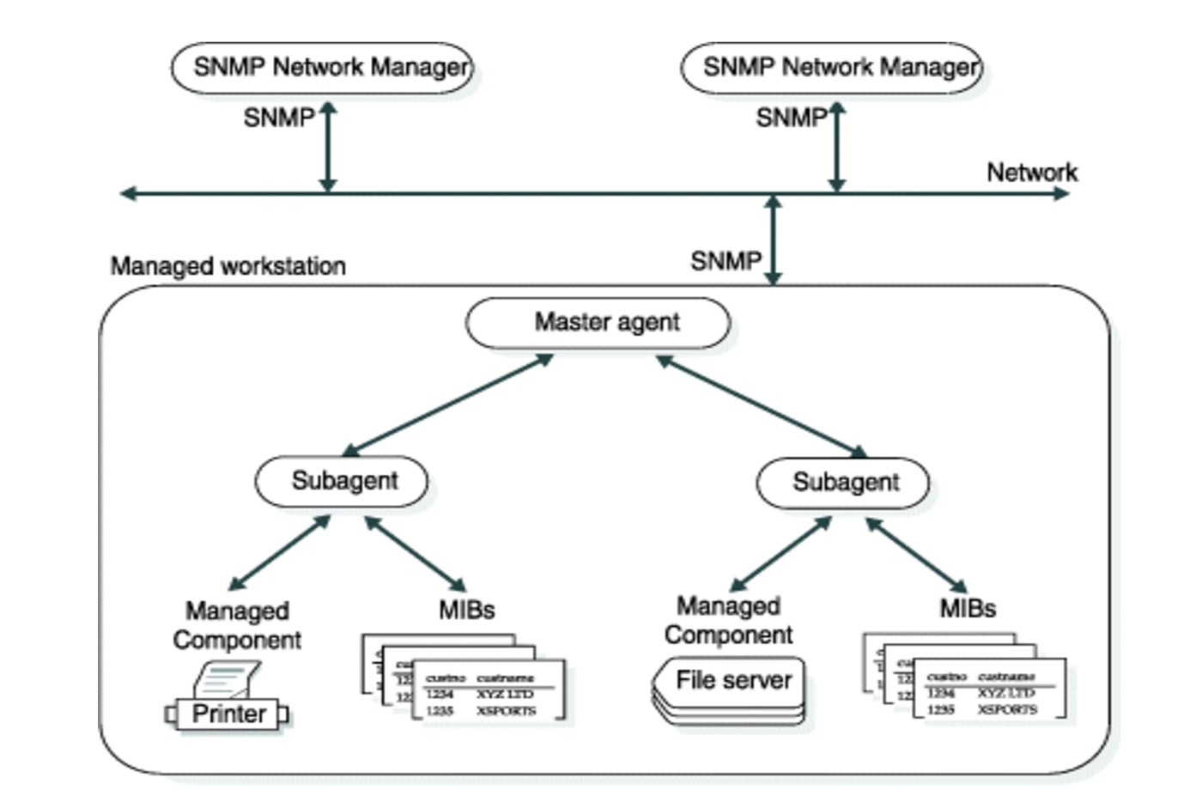
SNMP Architecture

Slide 5
SNMP Architecture
SNMP network managers An SNMP Network Manager is a program that asks for information from master agents and displays that information. You can use most SNMP Network Managers to select the items to monitor and the form in which to display the information.
Master agents A master agent is a software program that provides the interface between an SNMP Network Manager and a subagent.

Slide 6
SNMP Architecture
Subagents A subagent is a software program that provides information to a master agent.
Managed components A managed component is hardware or software that provides a subagent. For example, database servers, operating systems, routers, and printers can be managed components if they provide subagents.
Management Information Bases A Management Information Base (MIB) is a group of tables that specify the information that a subagent provides to a master agent. MIBs follow SNMP protocols.

Slide 7
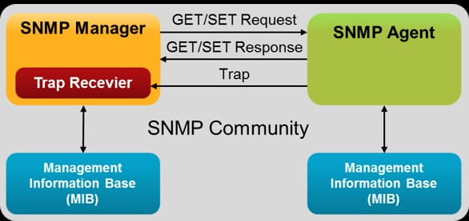
Components of SNMP

Slide 8
Components of SNMP
There are mainly three main components of SNMP
SNMP Manager: It is a centralized system used to monitor the network. It is also known as a Network Management Station (NMS). A router that runs the SNMP server program is called an agent, while a host that runs the SNMP client program is called a manager.
SNMP agent: It is a software management software module installed on a managed device. The manager accesses the values stored in the database, whereas the agent maintains the information in the database. To ascertain if the router is congested or not, for instance, a manager can examine the relevant variables that a router stores, such as the quantity of packets received and transmitted.

Slide 9
Components of SNMP
Management Information Base: MIB consists of information on resources that are to be managed. This information is organized hierarchically. It consists of objects instances which are essentially variables. A MIB, or collection of all the objects under management by the manager, is unique to each agent. System, interface, address translation, IP, udp, and egp , icmp, tcp are the eight categories that make up MIB. The mib object is home to these groups.

Slide 10
SNMP Messages
GetRequest : It is simply used to retrieve data from SNMP agents. In response to this, the SNMP agent responds with the requested value through a response message.
GetNextRequest : To get the value of a variable, the manager sends the agent the GetNextRequest message. The values of the entries in a table are retrieved using this kind of communication. The manager won’t be able to access the values if it doesn’t know the entries’ indices. The GetNextRequest message is used to define an object in certain circumstances.

Slide 11
SNMP Messages
SetRequest : It is used by the SNMP manager to set the value of an object instance on the SNMP agent.
Response : When sent in response to the Set message, it will contain the newly set value as confirmation that the value has been set.
Trap : These are the message sent by the agent without being requested by the manager. It is sent when a fault has occurred.
InformRequest : It was added to SNMPv2c and is used to determine if the manager has received the trap message or not. It is the same as a trap but adds an acknowledgement that the trap doesn’t provide.

Slide 12
SNMP Commands
The purpose of SNMP commands is to help network administrators monitor, manage, and troubleshoot devices like routers, switches, servers, and printers in a network.
Think of it as a way for administrators to "talk" to devices on the network, check their health, and make adjustments remotely. Here's how each command serves a meaningful
role:SNMP Command Purposes in Simple Terms
snmpget – Ask for one thing
Purpose: To ask a device for a specific piece of information, like "What is your name?" or "How long have you been running?"
Example: Check the uptime of a server.

Slide 13
SNMP Commands
snmpwalk – Get a list of details
Purpose: To ask a device to give you a list of all related details, like "Tell me everything about your network interfaces."
Example: Get all information about a router's ports and connections.
snmpset – Make a change
Purpose: To send a command to a device to update or fix something, like changing its contact email or resetting a setting.
Example: Update a printer's contact details so the support team knows who to call.
snmpbulkget – Get more data at once
Purpose: To quickly get a lot of information from a device with fewer requests, saving time and resources.
Example: Check the status of multiple sensors in a data center.

Slide 14
SNMP Commands
snmptrap – Get alerts
Purpose: Devices can send you a notification when something important happens, like a "help button" they press automatically.
Example: A switch sends a trap when a port goes offline.
snmptable – Summarize data in a table
Purpose: To view structured information, like showing all network interface statistics neatly in rows and columns.
Example: Display a summary of bandwidth usage on all ports of a switch.
snmpdf – Check disk usage
Purpose: Quickly check how much space is left on storage devices in the network.
Example: See if a server's hard drive is almost full.

Slide 15
Characteristics of SNMP
SNMP is used to monitor network
It detects any network faults
Can also be used to configure remote devices.
Allows a standardized way of collecting information about all kinds of devices from various manufacturers among the networking industry.

Slide 16
Conclusion
The Simple Network Management Protocol (SNMP) is an important protocol for managing and monitoring network-connected devices in IP networks. It enables administrators to effectively monitor network performance, discover and address errors, and configure remote devices. While SNMP’s simplicity and popularity provide significant advantages, it also has drawbacks, such as scalability concerns and high communication costs. Despite its drawbacks, SNMP remains an important in network management.

